Slide 1



Research and Development of a Sustainability Model for Community & Small Commercial Media
Findings Presentation

Slide 2

Agenda
Project Objectives and Research Methodology
Overall Sustainability of the CSCM Sector
Questions
Key Findings and Recommendations

Slide 3


STRATEGIC OVERVIEW OF THE MDDA
Section 16:
Everyone has a right to Freedom of Expression
Section 32: Everyone has a Right to Access to Information
Section 15 (1)
“Everyone has the right to freedom of conscience, religion, thought, belief and opinion
Notes:
2

Slide 4
MDDA MANDATE
Encourage ownership and control of, and access to, media by historically disadvantaged communities as well as by historically diminished indigenous language and cultural groups
Create an enabling environment for media development and diversity that reflects the needs and aspirations of all South Africans
Promote media development and diversity by providing support primarily to CSCM projects
Encourage the channelling of resources to the community media and small commercial media sectors
Redress exclusion and marginalization of disadvantaged communities and persons from access to media and the media industry
Encourage the development of human resources and training, and capacity building within the media industry, especially among historically disadvantaged groups
Raise public awareness regarding media development and diversity issues
5

Slide 5
Project Objectives & Research Methodology

Slide 6
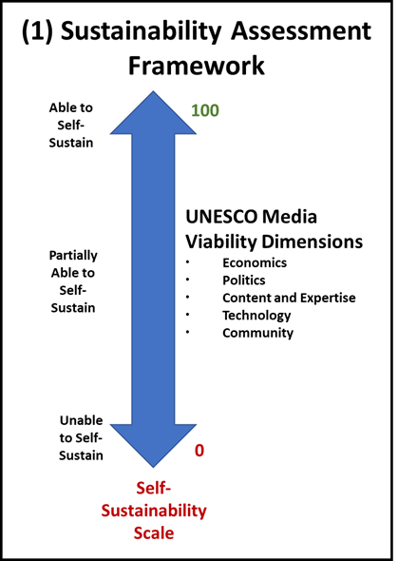
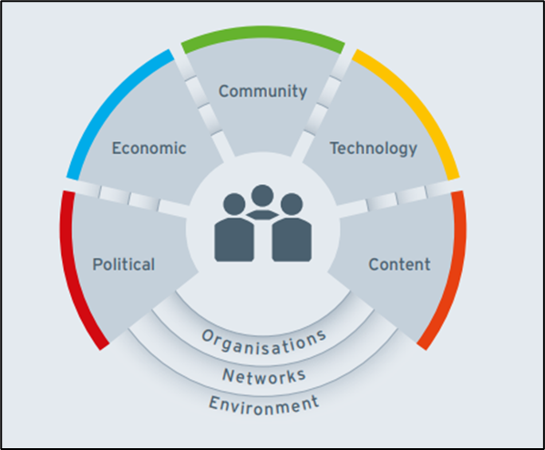
Objective and Approach
To develop a Sustainability Model for the CSCM sector in South Africa, which categorises the sector according to its ability to self-sustain, partially sustain; or inability to self-sustain for focused, responsive and proactive support.
Notes:
The Media Viability Indicators look at five societal dimensions that influence the functioning and quality of media, the rationale for having the Media viability indicators being a framework that underpins this study is because it is important to acknowledge that the sustainability of media goes far beyond the solvency and profitability of media outlets and measuring sustainability needs to consider a wide range of factors
The economic dimension relates to the financial and economic factors influencing the media market, media organisations and their audiences in a particular country.
The political dimension relates to the political and legal environment within which a particular media organisation exists. This dimension focuses specifically on how the political and legal environment impacts the diversity of views represented in media content, as well as the extent to which media is influenced and controlled by the government.
The content and expertise dimension relates to the ownership of media organisations in a particular country, the independence of these media organisations and the overall quality of journalism within a particular sector
The technology dimension relates to media’s access to production and distribution resources and technologies, and their ability to optimise the use of said resources.
The community dimension relates to the relationship that exists between media organisations and the community which the organisation serves. This considers multiple factors, from the community’s ability to evaluate the quality of content produced by media organisations to whether there is availability of reliable data about media organisations’ audiences and their media uses

Slide 7
Respondent Demographics
Notes:
The research employed both desk-based and field methods:
Desk-Based Research: Reviewed local and international literature on media viability, regulatory impacts, and sector challenges.
Field Research: Included surveys, interviews, and focus groups with 201 stakeholders, covering community organizations, government entities, and advertisers.
Frameworks: UNESCO Media Viability Indicators and MDDA's six sustainability pillars (Technology, Governance, Content, Print Media Transformation, Government Support, and Audience Measurement) were used to assess and support sustainability.
The survey respondents were classified according to four organisation types, namely community radio, small commercial publisher and/or newspaper, community publisher and/or newspaper and community television.

Slide 8
Overall Sustainability

Slide 9
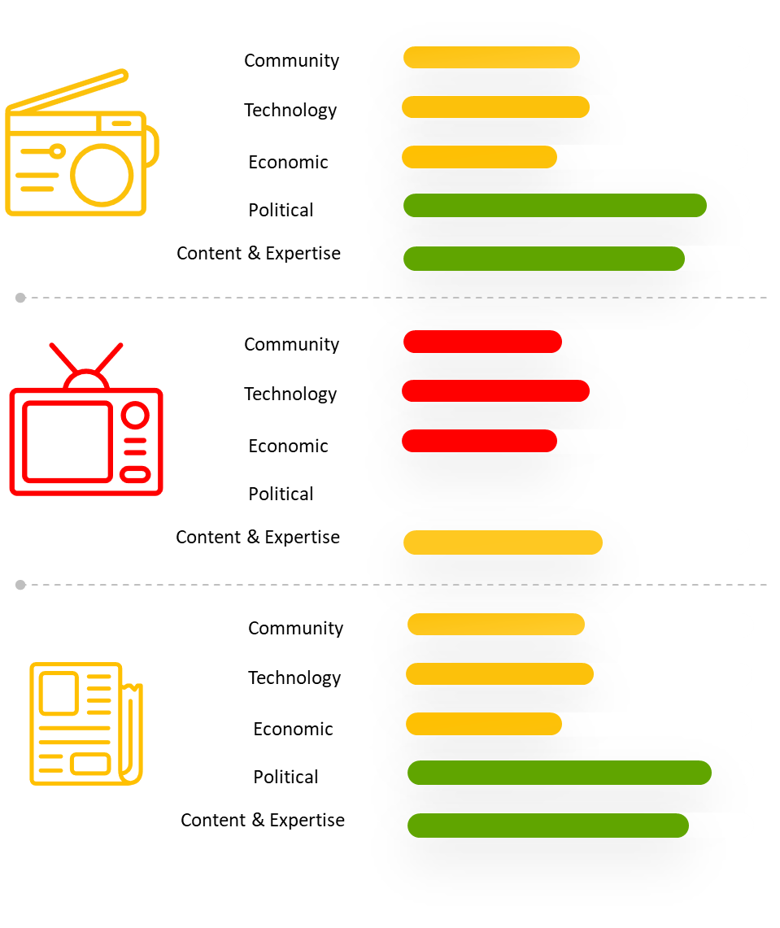
Overall Sustainability of CSCM Sector
Partially Sustainable
74%
Not Sustainable
19 %
Sustainable
7 %
Notes:
Despite existing MDDA support, the sector remains partially sustainable. Key issues include insufficient funding, limited revenue streams, high staff turnover, and a lack of professional skills and governance. Only 7% of respondents considered their organizations sustainable.
What was interesting to find when looking at overall sustainability by province was that no survey respondents in KwaZulu Natal & Gauteng considered their organisation to be sustainable. This is interesting because these are the two provinces where the MDDA has the largest footprint/presence which forces us to introspect on the impact we are making generally and the impact we are making in these provinces. Similarly, no survey respondents in the Free State, Northern Cape and Mpumalanga considered their organisation to be sustainable.
On the other hand, 33% of survey respondents from the Northern Cape indicated that their organisation is not sustainable, followed by 29% who indicated the same in Gauteng. Similarly, 25% of respondents from the Free State indicated that their organisation was not sustainable, while 20% of respondents from Mpumalanga indicated the same. These results indicate that the CSCM organisations most in need of targeted, focused support from the MDDA are located in the Northern Cape, Gauteng and Free State provinces. The provincial analysis indicated above is the lowest level of geographical analysis possible with the available data.

Slide 10
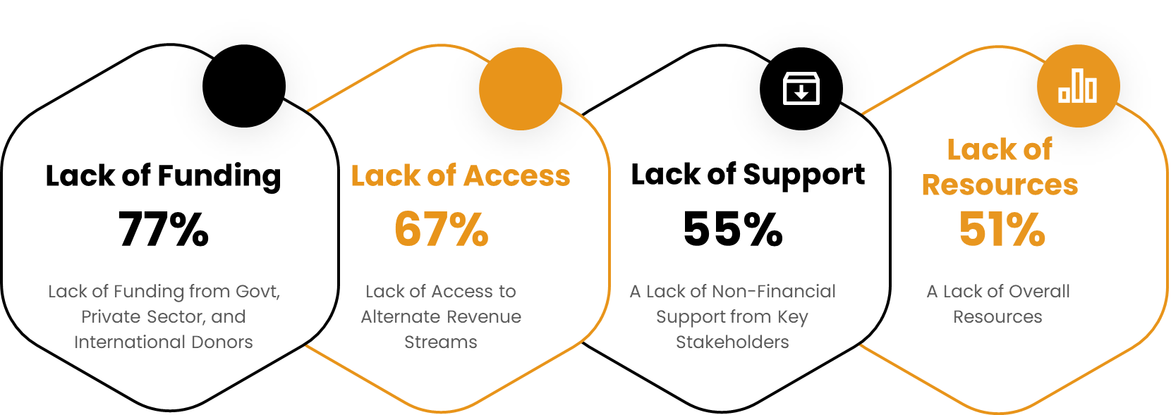
Overall Sustainability of CSCM Sector
Challenges Affecting Sustainability
Notes:
Based on the UNESCO Media Viability Indicators, the sustainability of the sustainability of each media type, namely community radio, community television, community and small commercial print, was assessed.
Community radio is the most sustainable of the three media platforms, achieving a sustainability score of 55. Community radio was, therefore, rated as partially sustainable. Community and small commercial print media received a similar rating of partially sustainable, achieving a sustainability score of 51, while community television achieved the lowest sustainability score of 22, and was, thus, rated as not sustainable.

Slide 11
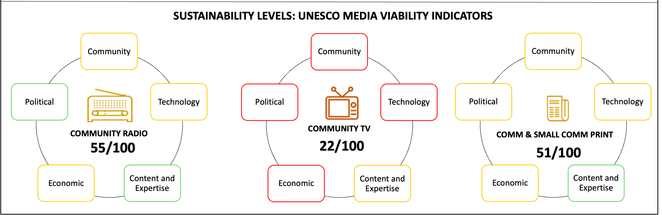
Overall Sustainability of CSCM Sector
Notes:
Based on the UNESCO Media Viability Indicators, the sustainability of the sustainability of each media type, namely community radio, community television, community and small commercial print, was assessed.
Community radio is the most sustainable of the three media platforms, achieving a sustainability score of 55. Community radio was, therefore, rated as partially sustainable. Community and small commercial print media received a similar rating of partially sustainable, achieving a sustainability score of 51, while community television achieved the lowest sustainability score of 22, and was, thus, rated as not sustainable.

Slide 12
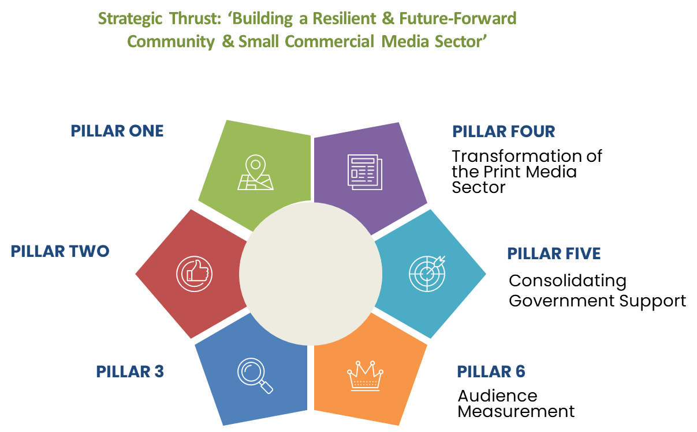
Overall Sustainability of CSCM Sector
Notes:
The MDDA’s Sustainability Pillars were developed by the MDDA in order to identify and document the specific issues that were believed to be impacting the sustainability of the CSCM sector. The model comprises six pillars, each relating to a specific issue in the CSCM sector.
In order to understand the impact of each pillar on the sustainability of the CSCM sector, the MDDA Sustainability Pillars were mapped to the UNESCO Viability Indicators. This exercise allowed for the identification of key issues impacting on the sustainability of the CSCM sector.

Slide 13
Key Findings

Slide 14
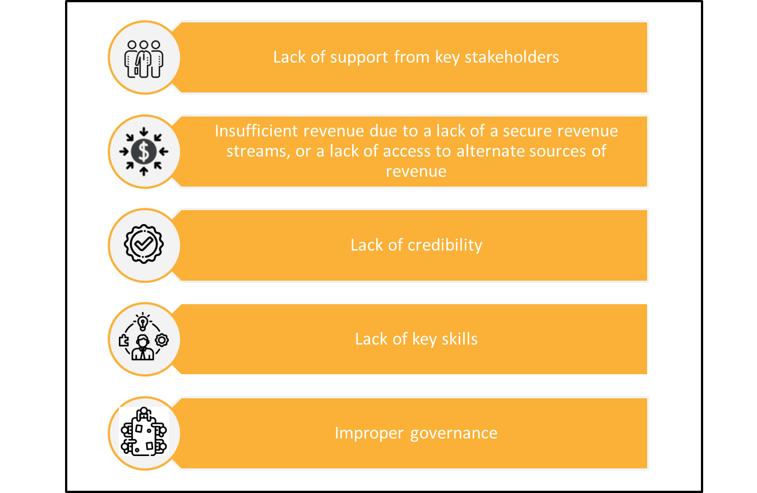
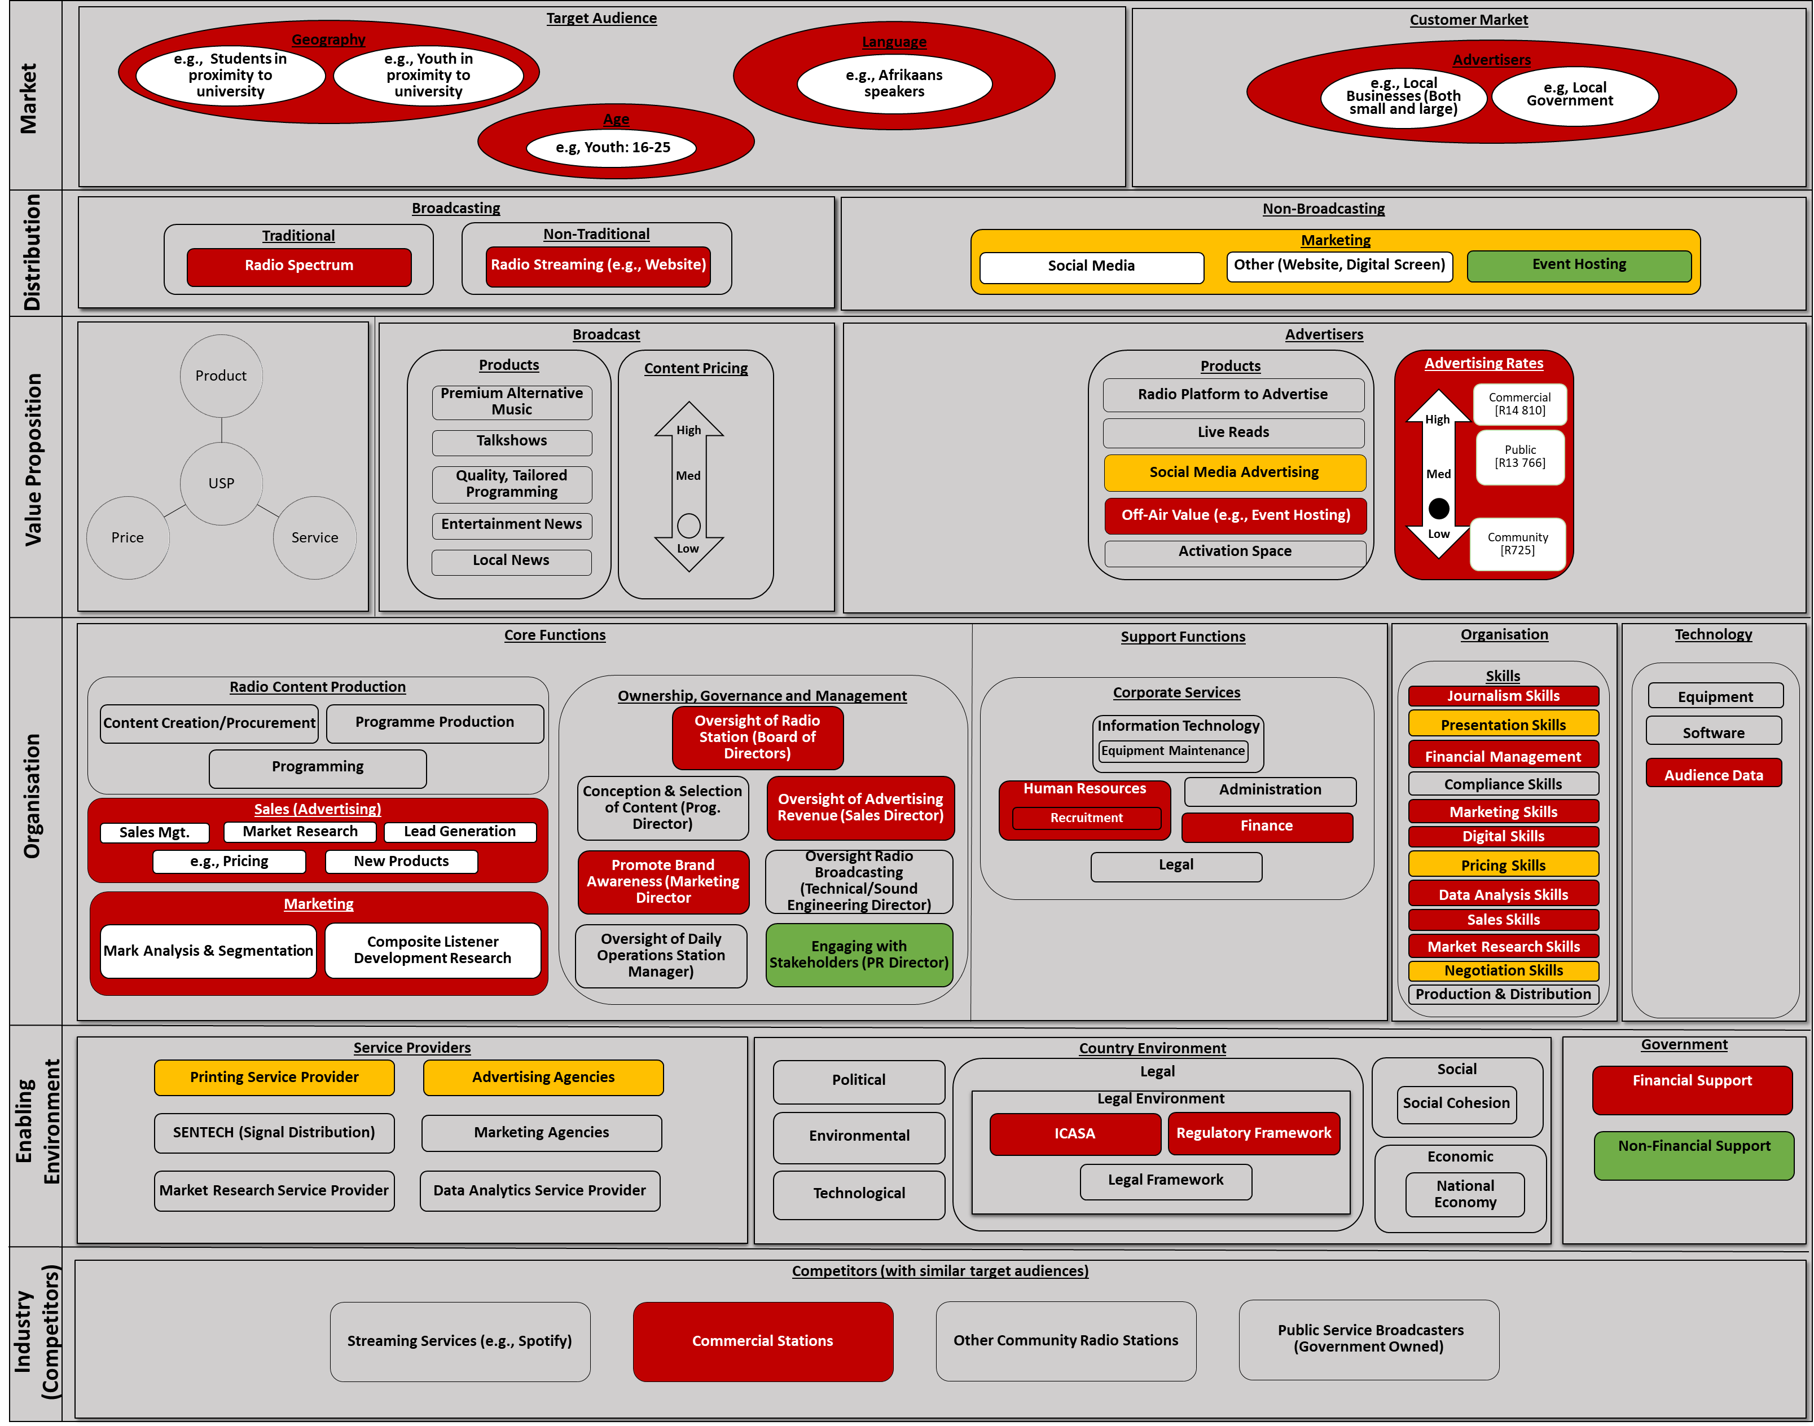
Root Cause Analysis
Legend
 | Positive Practice
 | Minor Challenge
 | Major Challenge

Slide 15
Root Cause Analysis
Lack of sufficient revenue causes a multitude of other challenges:
Inability to attract advertisers due to lack of skills and credibility (lack of detailed audience data)
Lack of key skills and business functions due to inability to afford and retain skills staff
Perception of “instability”
Notes:
The root cause analysis highlighted the need for better support, operational cost reduction, improved access to key skills, and the importance of professional credibility for attracting advertisers.

Slide 16
Recommendations

Slide 17





Sustainability Strategies
Provision of Shared Services through Shared Service Centers
Revenue Generation Strategies
Grant Funding
Explore possibility of Self-Transmission

Slide 18
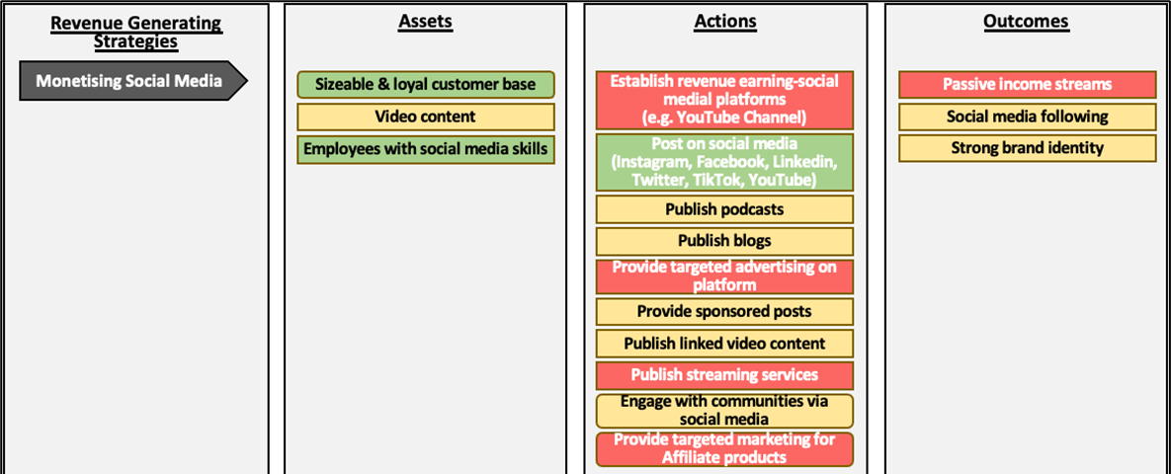
Revenue Generation Strategies
Notes:
One of the most relevant revenue streams for CSCM organisations in the contemporary economic environment is the use of social media platforms and tools to generate revenue. It is key to bear in mind that a CSCM being active on social media does not equate to it deriving revenue from social media.
Uploading a video to YouTube is very different from setting up a YouTube channel that generates subscription fees and sizeable advertising revenue.
Some of the ways in which social media platforms can be used to generate income include affiliate marketing, monetising videos, creating pay-for-entry membership groups and brand partnerships.
As of January 2024, there were 45.3 million internet users in South Africa; 26 million of whom used social media. This represented around 43% of the total population

Slide 19
Thank you!

